Slide 1
PG Cert Action Research Project Sarah Masters Specialist Technician Costume for Performance London College of Fashion.
“The information that animates the world is dominated by non-disabled bodies, by a specific hegemonic form of carnality which excludes as it constructs” Patterson and Hughes (1999)
Image from https://www.arts.ac.uk/colleges/london-college-of-fashion/about-lcf/lcfs-move

Slide 2
Identifying barriers: What are the contributing factors on the BA and MA costume courses that prevent students with physical disabilities/mobility impairments from applying or succeeding on the course? Identifying barriers: What are the contributing factors on the BA and MA costume courses that prevent students with mobility disabilities from applying or succeeding on the course?

Slide 3
Positionality
I am from a white working-class background, and I have a BA hons in costume for performance from UAL. I am currently the specialist technician in costume for performance at London College of Fashion and I work with the BA and MA courses. I am an abled bodied woman and was diagnosed with learning difference in 2007. I have experience in applying for ISAs and DSA within UAL as I have applied for these as a student myself, and I recognise that I have a bias here. My learning difference also gives me insight on being a disabled student within UAL and how important inclusive learning environments are for students to flourish.

Slide 4
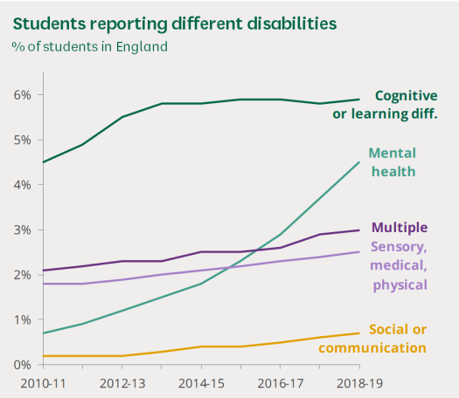
Rationale
UAL’s EDI report 21/22 shows that 15% of UAL students declared a disability. (2022) This percentage is made up of learning differences, neurodiversity, sensory, medical and physical disabilities.
According to a report conducted by Bolton and Hubble (2021) In 2019, only 2.5% of students in the UK had declared a sensory, medical of physical disability. Students who are wheelchair users or have mobility impairments are almost the lowest represented disabled students in the UK.
Learning about the social model of disability in the IP unit inspired my ARP. Understanding that it is not the condition, but the barriers in society that disables people.
In my 6 years as a technician at LCF, I have seen students with varying disabilities but none with mobility disabilities. With the move to East Bank, a new and accessible building, I want to find potential barriers within my workshops that may prevent students applying/succeeding to remove them and create an inclusive space.
“Removing these barriers creates equality and offers Disabled people more independence, choice, and control.” Disability Rights UK (2022)
Support for disabled students in higher education in England. Bolton and Hubble (2021)

Slide 5
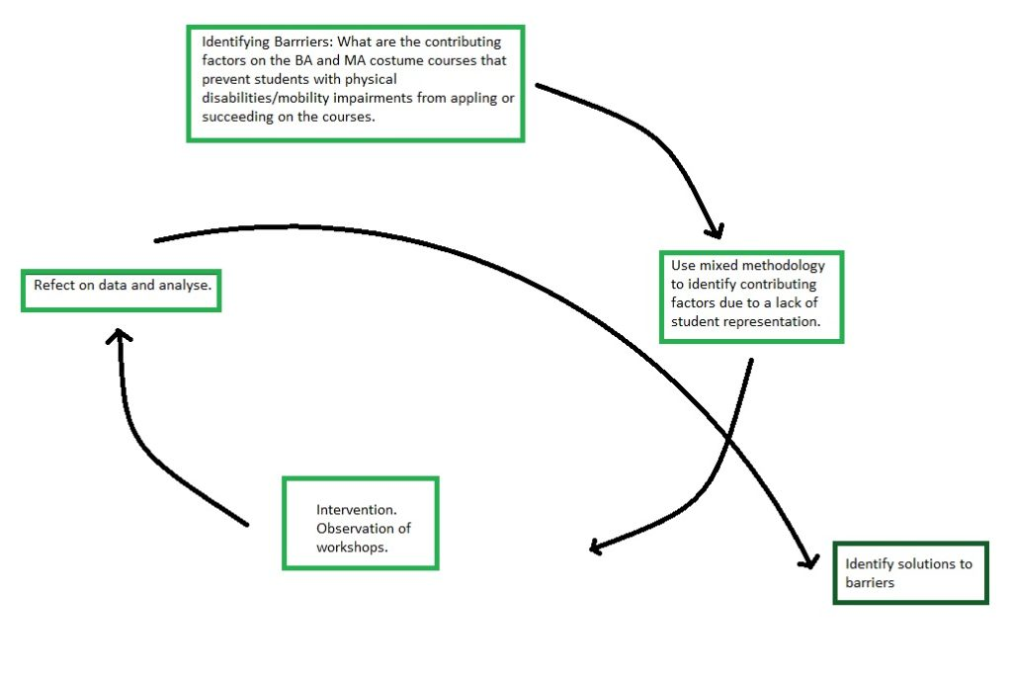
Research methods and Intervention.
Student participation not possible due to lack of representation - Currently there are no students who are wheelchair users at London College of Fashion.
Staff were happy to talk but reluctant to officially participate due to fear of repercussions.
The Performance disability advisor was enthusiastic about my project but had no availability until January due to overseeing 800 students with disabilities at LCF and LCC.
It came clear to me that I would need to used mixed methods to collect quantitative and qualitative data to help answer my question. For my first spiral, I wanted to focus on the costume rooms and see if students who are wheelchair users or those with mobility aids could access all parts of the room and the equipment. By completing a room observation as my intervention, I could take measurements and do a comparative analysis with secondary research on average mobility aid dimensions. This also reduced ethical implications.
I would also conduct an interview with the disability advisor when she was available to find out more about the ISA process and how they identify barriers for individual students.
My action research cycle – Authors own.

Slide 6
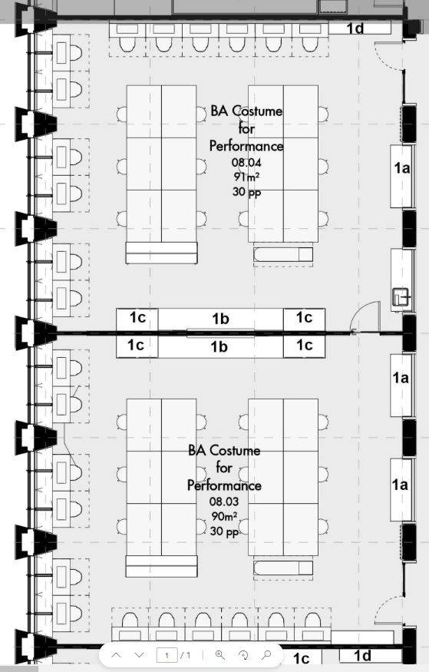
Room Observation – My intervention
EB 823 and 824 layout
I observed one room EB 823 as rooms are set up identically. Room layout was designed without technical input and is difficult to change due to plug socket availability. Managers also wish to keep aesthetics the same through the building.
“Mobility and movement are also dependent upon access from one place to another and, for disabled people, to be able to move through spaces unimpeded by physical objects.” Imrie, R., 2000
Level 8 updated floorplan (2022)

Slide 7
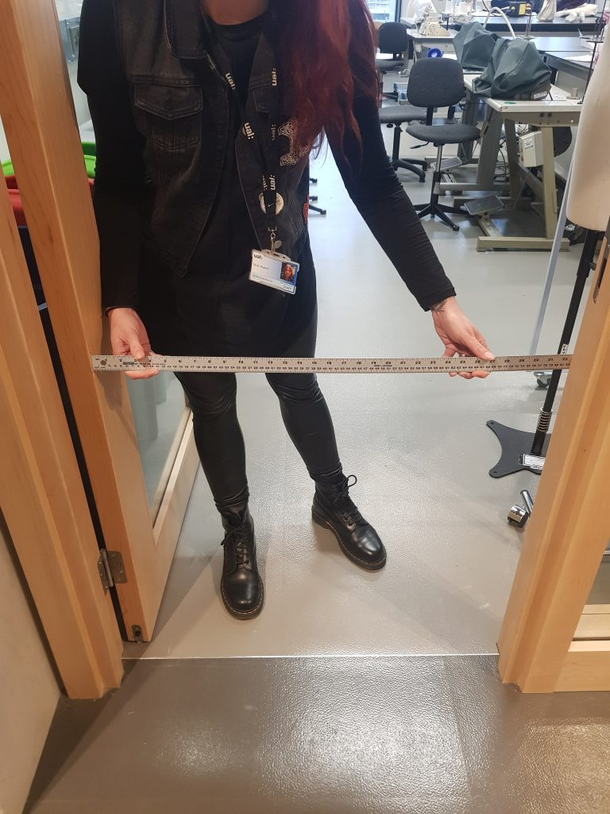
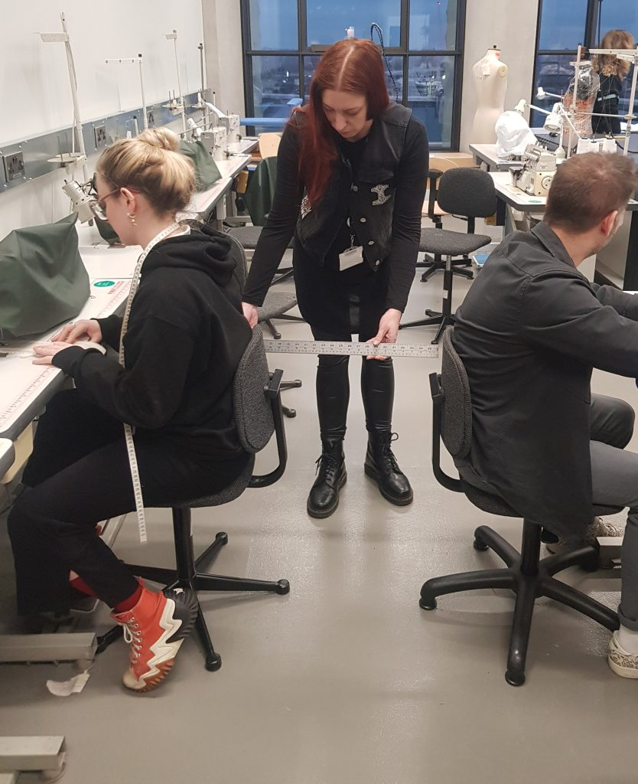
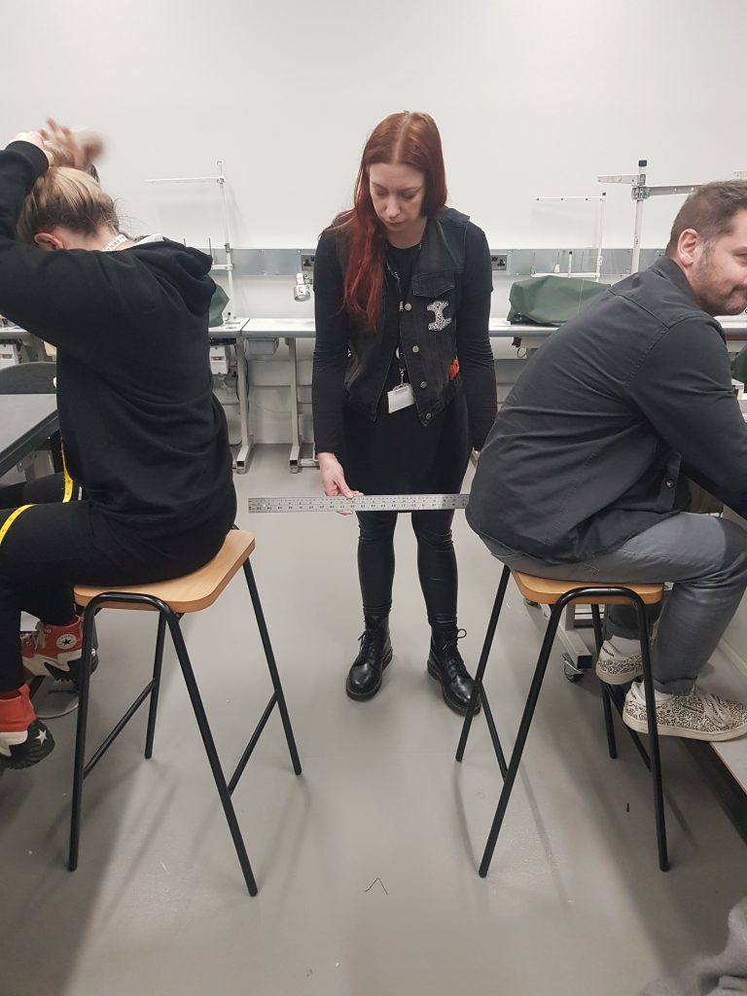
Door width 820mm
Width between machine chairs 520mm
The distance between stalls is 560mm.
Door to EB 823 (2023) Authors own
Occupied machines (2023) Authors own
Occupied Distance between the stalls (2023) Authors own

Slide 8
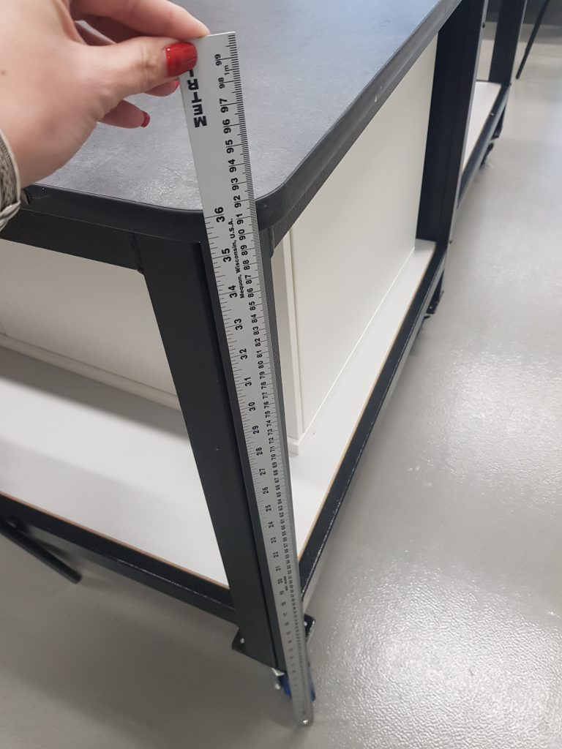
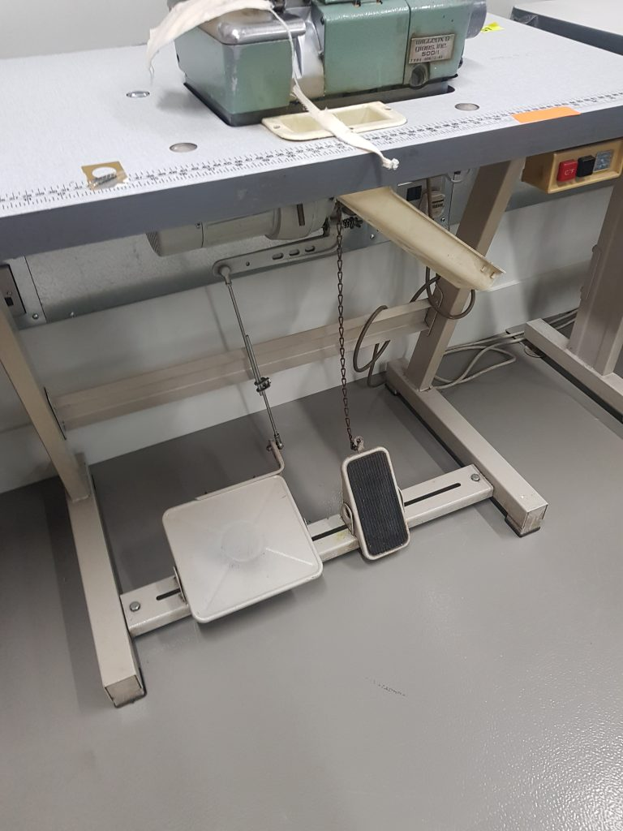
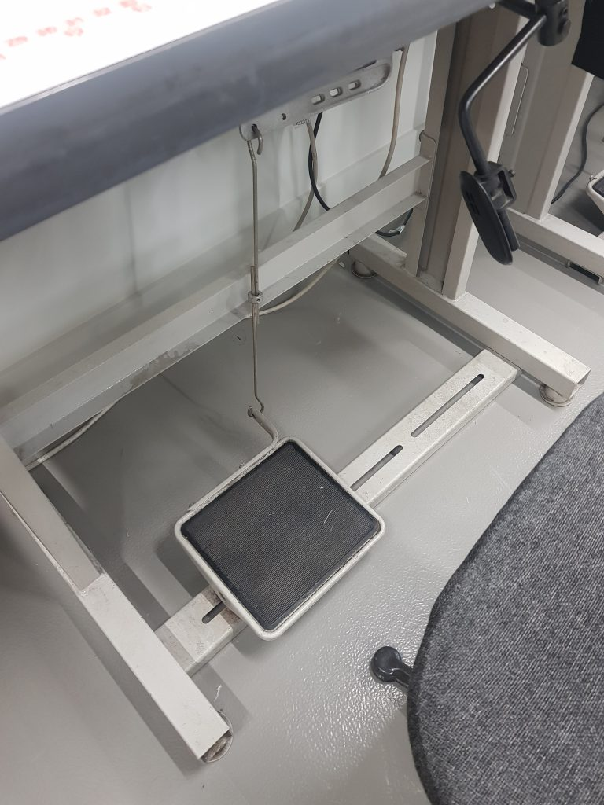
Pattern tables 920mm high
Pattern cutting table height EB823 (2023) Authors own
Overlocker machines (2023) Authors own
Lockstitch machine (2023) Authors own

Slide 9
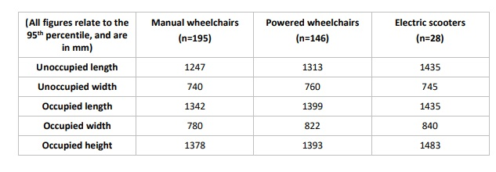
Data analysis.
I chose comparative analysis as I felt this would give me more direct answers to see how accessible the workshop was. I obtained secondary data from a research report conducted by Barham, Greenshields and Mitchell (2020) which gives average dimensions for manual and electronic wheelchairs. I conducted my own desk research to gain average measurements for wheeled mobility aids. I used this information compared to those I took during the room observation to determine how accessible the room was.
Barham, Greenshields and Mitchell. Accessible Public Realm: Updating Guidance and Further Research Technical Annex 2: A review of the dimensions of wheeled mobility aids 2020: 18

Slide 10
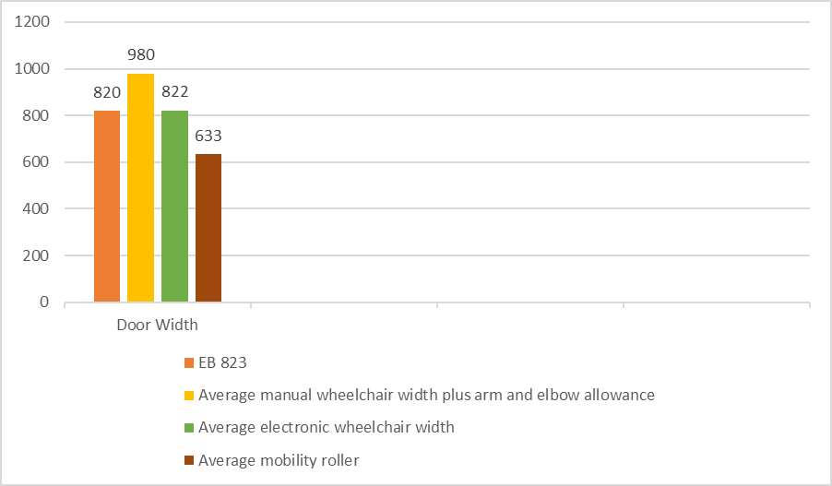
Door Entry
As suggested by Barham, Greenshields, and Mitchell (2020: 14) preferably 100mm, should be allowed on each side of the wheelchair for the user’s hands and elbows regarding manual wheelchair dimensions. This has been added to the measurements in my data analysis.
Door width (2023)Authors own.

Slide 11
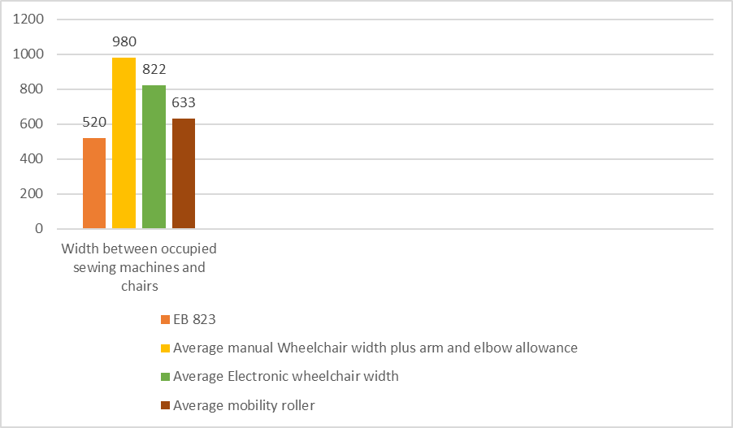
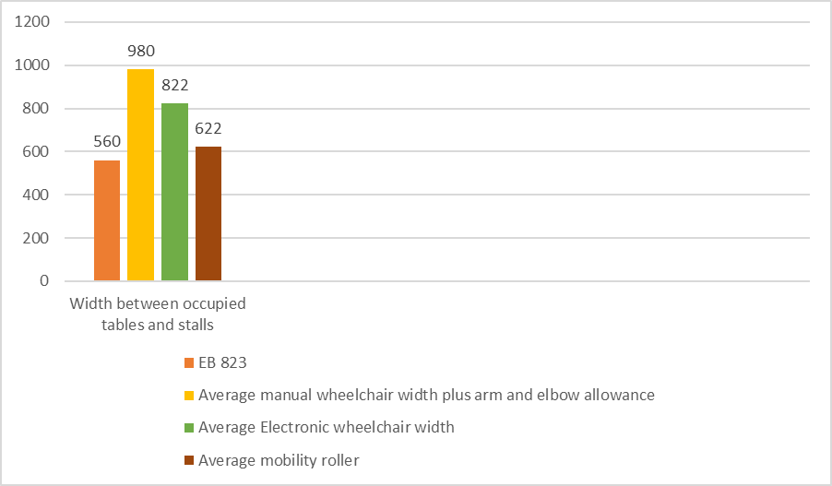
Path between occupied sewing machines and chairs.
Path between occupied pattern cutting tables and stall.

Slide 12
Sewing machines and tables.
All machines require the use of a foot pedal to operate machines.
Tables are high and not adjustable. The storage shelf would prevent a wheelchair user from getting close to the table.
Tables were designed for the user to stand at.

Slide 13
Conclusions of room observation:
I identified 5 main barriers within the workshop
Door entry
Pathway between machines too narrow
Path between tables too narrow
Industrial machines not accessible
Tables too high
The room layout is currently not accessible for students who require mobility aids. As it stands, we currently have no industrial machines that can be used by wheelchair users, and potentially those with mobility impairments depending on condition. The only option we have for students is the use of domestic (at home) machines that are usable without a foot pedal. These are used in the rooms for certain garments and are used on the pattern cutting tables by students. As the tables are also an issue, the only option would be for students to use these in the heart space outside of the classroom. The detrimental and isolating effect this could have on a student has to be considered.
It is clear that students with mobility disabilities would not be able to use the practical equipment currently used on the course. This would impede their success on the course and could be a fundamental reason as to why they are not applying.

