Slide 1
Interview with the Performance disability advisor.
1. At what stage do students usually approach you in regards to ISA's or adjustments?
2. Is it common during open days to be approached by students with physical disabilities or mobility impairments?
3. How important do you think it is having accessible equipment, furniture and machines already in place during open days for potential students to apply?
4. If a student with physical disabilities or mobility impairment are unaware of potential barriers that may be in place on a practical course, say for example sewing machines they may not have seen before, what is the process of discussing this or discovering these barriers?
5. Is there a timeline for courses to get equipment adjustments in place?
6. Is there funding available for courses to make specific adjustments and what is the process of accessing that?
7. Are there any common barriers that get discussed with you in terms of equipment and machines for students with physical disabilities?
8. Is there anything you think is important to add?

Slide 2
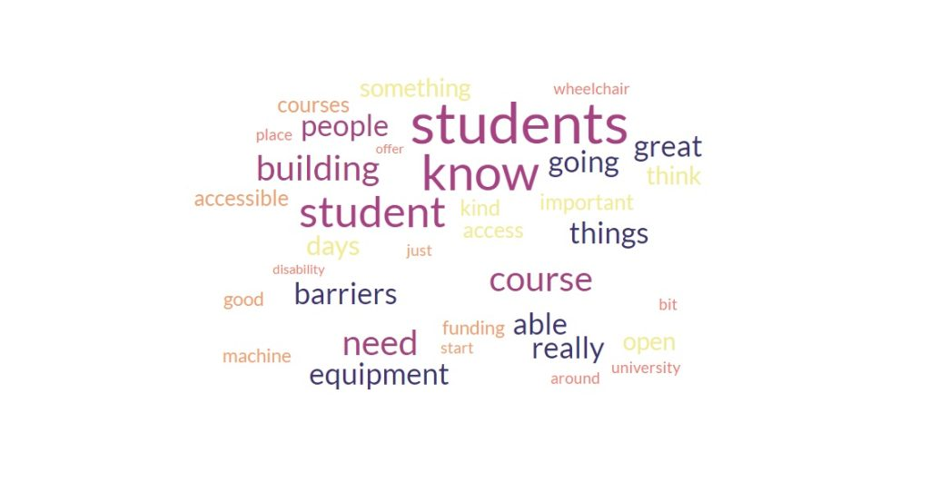
Analysing interview transcript.
Key points I learned from the interview.
Open days can be fundamental for disabled students choosing or rejecting a university/course.
Barriers may take time to identify if the student is unfamiliar with processes that will be learned on the course.
The disability advisors do not have specialist knowledge of the courses allocated to them. It may become a team effort to identify barriers, but this can take time.
Funding can come from DSA or university budgets. Both can take months before funding is received, only then can equipment be ordered.
There is no funding for anticipatory adjustments. Funding is based on per student per individual needs and can take months to receive.
I used Microsoft live word dictate function to transcript the interview live which work very well. I also used my phone as a back to correct any errors on the transcription. Full transcription available on my blog
I created a Word cloud from the transcripts for my thematic analysis.

Slide 3
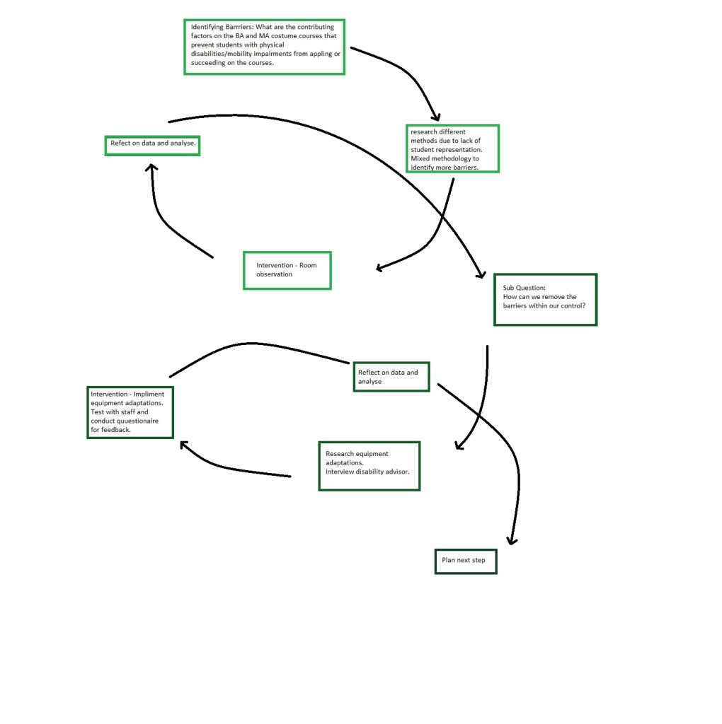
Barriers Identified: How can they be removed?
Through my ARP I have identified several barriers that I had not considered before. I knew the machines were a problem, but the space and consideration of open days are of such great importance. The next spiral of my research is how easy is it to remove those barriers that are within our control? If we can do this as part of our anticipatory duty, this will give the students a much more positive experience when they do enroll.
Action research second spiral. (2023) Authors own

Slide 4
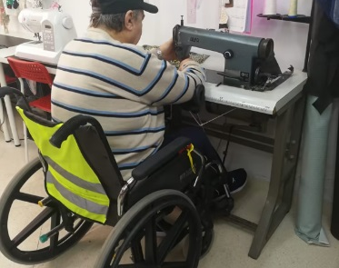
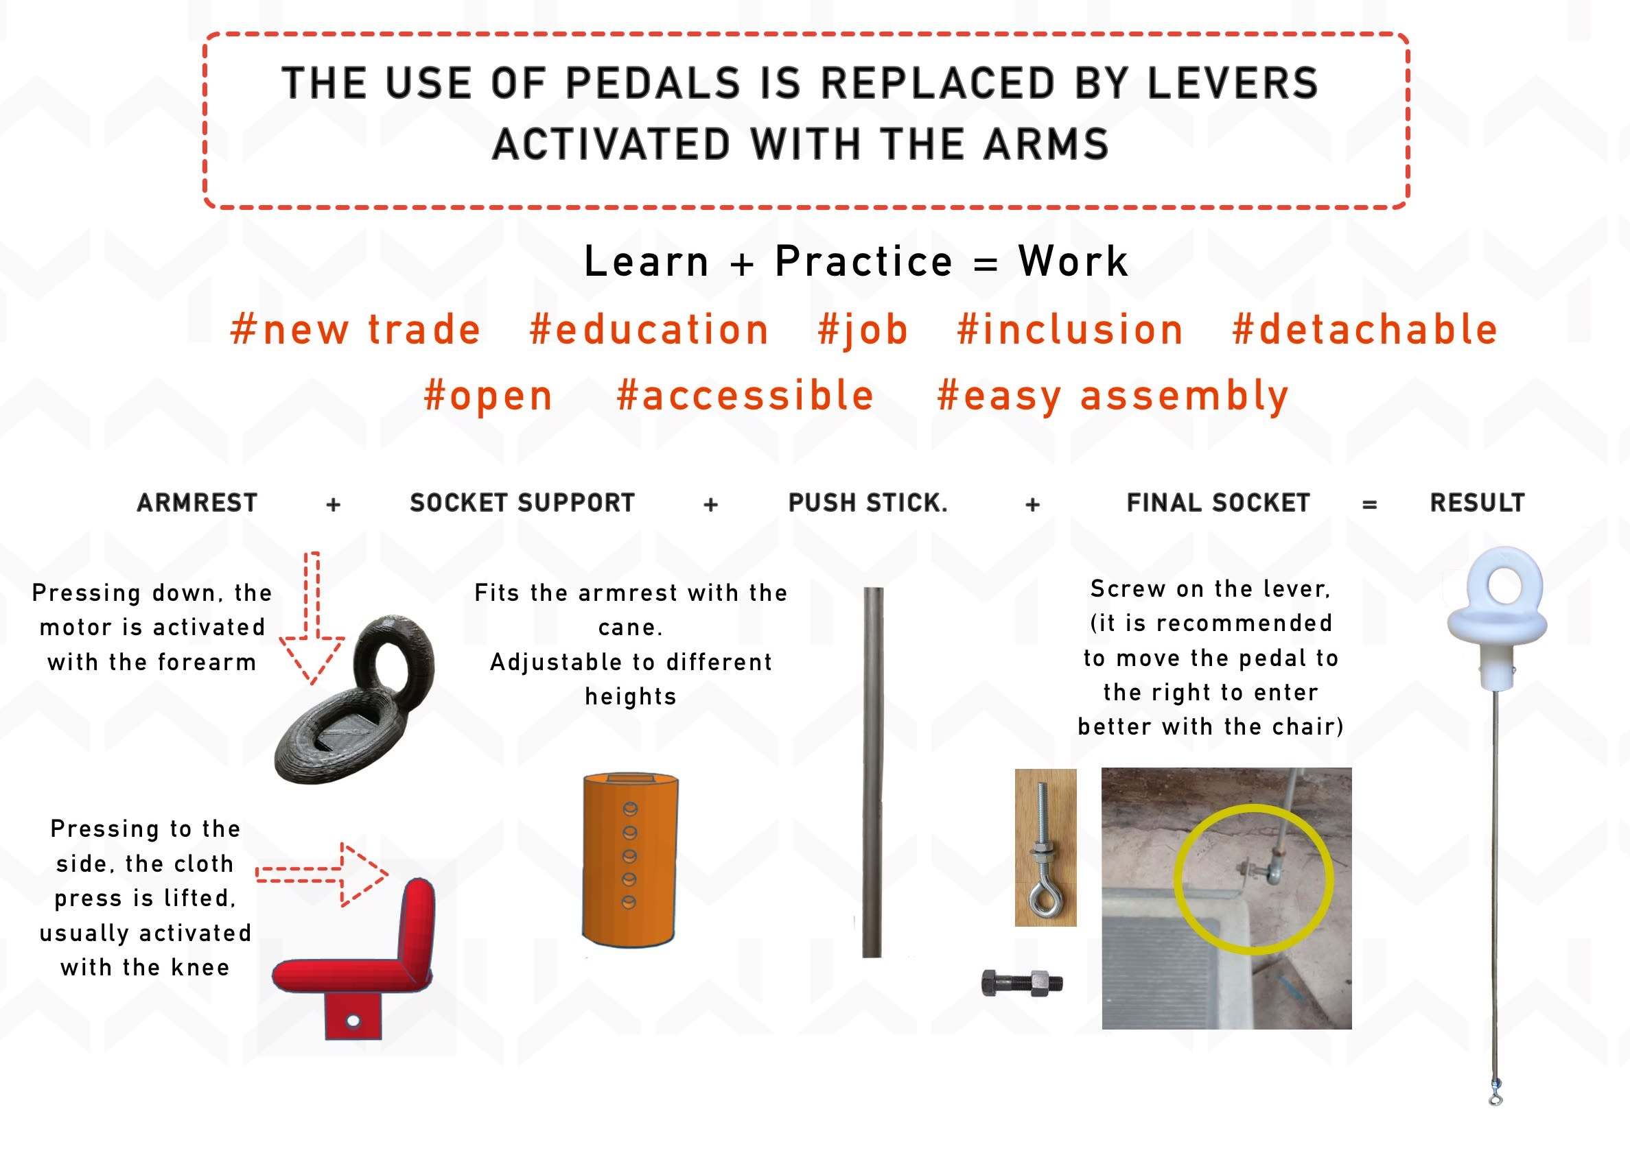
Moving Mood.
“Moving3Dmachine is an adaptation for industrial sewing machines designed for users with physical disabilities. The traditional use of pedals is replaced by levers activated by the arm, allowing people with reduced mobility to be employed in a sector such as fashion, which employs one in six people worldwide.
A system that is easy to attach, removable, and does not need to leave an adapted machine all the time.
Our aim is to offer more job and higher education opportunities for people with physical diversity. Promoting their autonomy and contributing directly to society. Find out more about our sewing machines for inclusive production.” Moving Mood” (2023)
Invented by Carlos Espinosa and adapted by Nestor Aparicio, the project was supported by Social Challenges Innovation Platform and funded by the EU to allow the Moving3Dmachine pattern to be downloaded free of charge on the Moving Mood website..
Images from movingmood.com

Slide 5
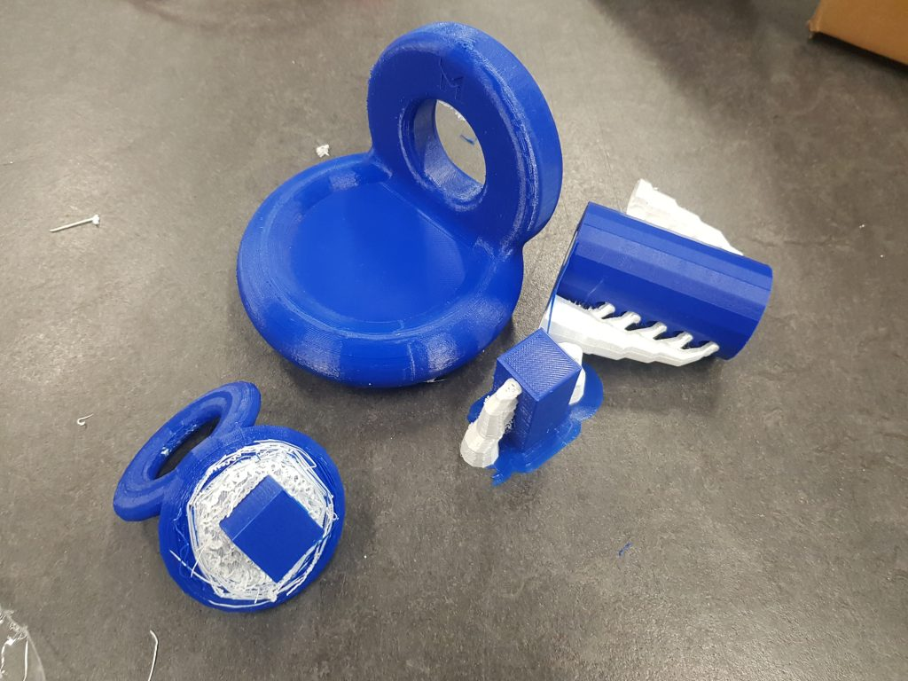
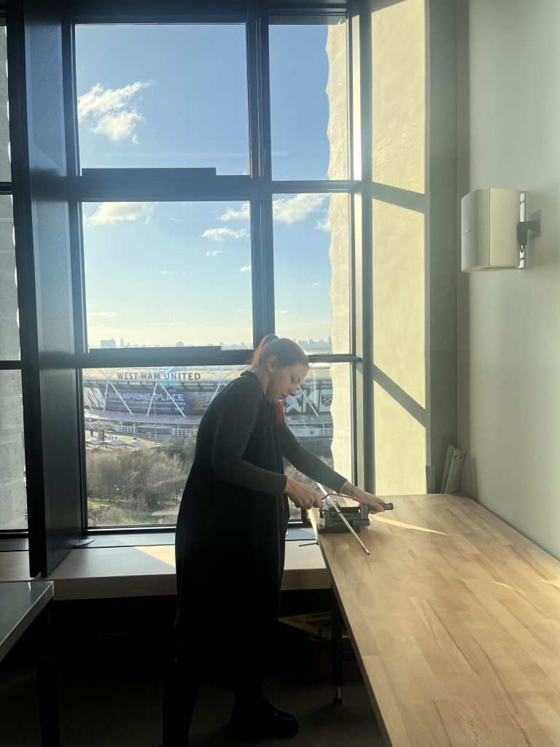
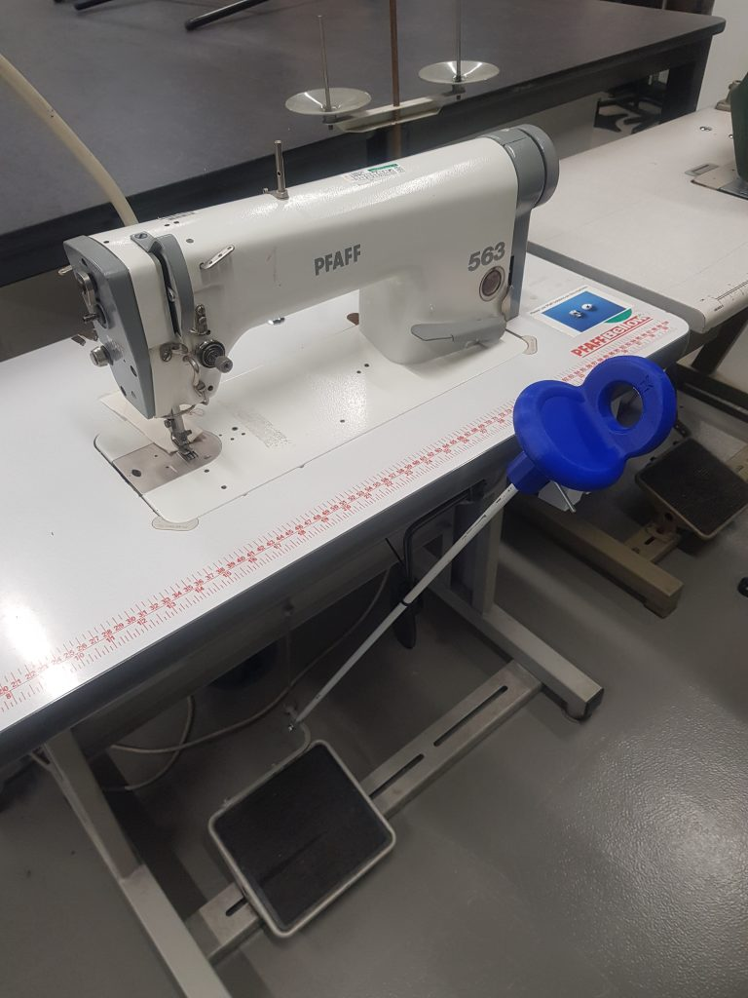
Moving3Dmachine was printed at LCC due to LCF’s LEV system not being operational. With the help and advice from LCF’s head sewing machine technician, and the 3D support technician, I was able to build and implement the adaptation to one of our industrial machines.
Moving3Dmachine 3D print(2023) Authors own
Cutting the rod (2024)
Moving3Dmachine applied. (2024)

Slide 6
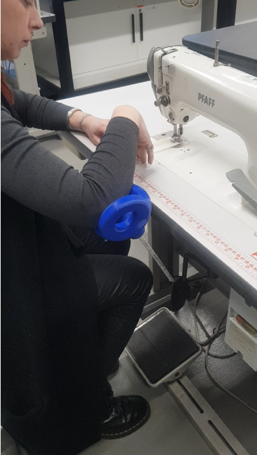
Video of machine in action (2024) Authors own
It works!
To lift the foot, using the arm, move the stick to the right. The power the machine, apply pressure from the top down. The harder you push, the faster the machine.
The rod is currently too high. I plan to develop this to make it height adjustable.
Machine was tested by all the costume technicians. Feedback forms were filled out and the results can be seen on https://sarahmasters.myblog.arts.ac.uk/
Total cost of Moving3Dmachine - £8.43

Slide 7
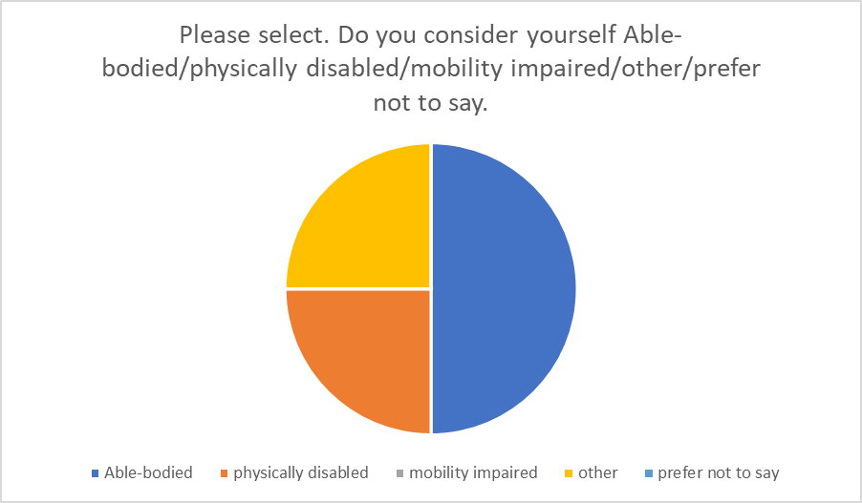
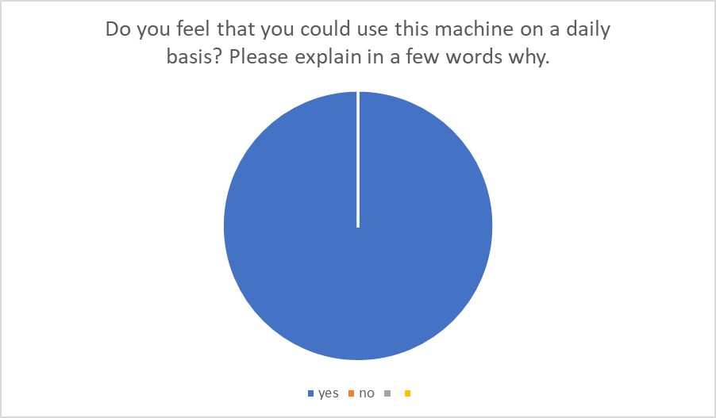
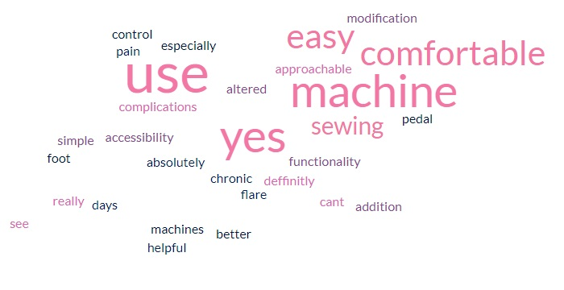
Feedback from Costume technicians.

Slide 8
Bibliography text
Barham, P. Greenshields, S. Mitchell, J. (2020) CLIENT PROJECT REPORT CPR2714 Accessible Public Realm: Updating
Guidance and Further Research Technical Annex 2: A review of the dimensions of wheeled mobility aids (RQ2) Available at https://assets.publishing.service.gov.uk/media/5e4d412986650c10e4580eb5/accessible-public-realm-annex-2-review-of-the-dimensions-of-wheeled-mobility-aids.pdf [Accessed[ 21th November 2023.
Disability Rights UK (2022) Social Model of disability: Language. Available at https://www.disabilityrightsuk.org/social-model-disability-language Accessed 20th November 2023
Imrie, R., 2000. Disability and discourses of mobility and movement. Environment and planning A, 32(9), pp.1641-1656. Available at https://www.researchgate.net/profile/Rob-Imrie/publication/23538979_Disability_and_Discourses_of_Mobility_and_Movement/links/5f113a484585151299a1353d/Disability-and-Discourses-of-Mobility-and-Movement.pdf [Accessed] 8th November 2023.
Moving Mood (2023) Sewing machines for inclusive production. Available at https://movingmood.com/en/consulting-services/sewing-machine-for-inclusive-production/#gutenslider-t9apnbhfv-6 Accessed 1st December 2023
Paterson, K. and Hughes, B., 1999. Disability studies and phenomenology: The carnal politics of everyday life. Disability & society, Available at https://www.tandfonline.com/doi/abs/10.1080/09687599925966?casa_token=Xyd9BpWbGqgAAAAA:wpURH6fUO638TrHaL4W5T7Cshjqq0TcGI0ahntBrN3BvPtxjx6_J_EKi2ISuWQR-aWReop_Lt3FcWg [Accessed] 8th November 2023
UAL (2022) Equality, Diversity and Inclusion Annual report 2021/22 Available ay https://www.arts.ac.uk/?a=389423 [accessed] 18th January 2024
University of Oxford (2024) Anticipatory duty. Available at https://academic.admin.ox.ac.uk/anticipatory-duty [Accessed] 20th December 2023

Slide 9
Bibliography Images
Bolton, P and Hubble, S. (2021) Support for disabled students in higher education in England Available at https://commonslibrary.parliament.uk/research-briefings/cbp-8716/ Accessed 25th November 2023
Masters, S. (21/11/23) Distances between chairs
Masters, S. (21/11/23) Distance between stall
Masters, S. (21/11/23)Door to EB 823
Masters, S. (21/11/23) Door width
Masters, S (2023) Door Width in EB 823 graph.
Masters, S (2023) Lockstitch machine
Masters, S. (04/11/23) My Action Research Cycle
Masters, S. (21/11/23) Occupied machines
Masters, S. (21/11/23) Overlock machine E823
Masters, S (2023) Path between occupied machines and chairs graph.
Masters, S. (21/11/23) Pattern cutting table height EB823
Masters, (2023) Width between occupied tables and stalls graph.
Masters, S (2024) Cutting the rod
Masters, S (2024) Moving3Dmachine applied.
Masters, S (2024) Video of machine in action
Masters, S. (2023) Action research second spiral.

Slide 10
Bibliography images continued
Moving Mood (2023) Sewing machines for inclusive production. Available at https://movingmood.com/en/consulting-services/sewing-machine-for-inclusive-production/#gutenslider-t9apnbhfv-6 [Accessed] 1st December 2023
Rapid Ramp (2023) Table 2 minimum effective clear widths of doors. Rapid Ramp door widths. Available at https://www.rapidramp.co.uk/product-news/the-correct-wheelchair-door-width [Accessed] 25th November 2023
UAL (2019) East Bank. Available at https://www.arts.ac.uk/colleges/london-college-of-fashion/about-lcf/lcfs-move [Accessed] 18th January 2024
UAL (2022) Level 8 floor plan. Available at https://artslondon.sharepoint.com/sites/MediaDepartment/Shared%20Documents/Forms/AllItems.aspx?id=%2Fsites%2FMediaDepartment%2FShared%20Documents%2FGeneral%2FStratford%2FILLUSTRATIVE%20PLAN%20M%26P%20UPDATED%20LEVEL%2008%20%2D%20220622%2Epdf&parent=%2Fsites%2FMediaDepartment%2FShared%20Documents%2FGeneral%2FStratford [Accessed] 18th January 2024

